Slide 1
Vulcan Defect Status
Mar. 14, 2016
Tao Wu, Wen Yi Gao

Slide 2
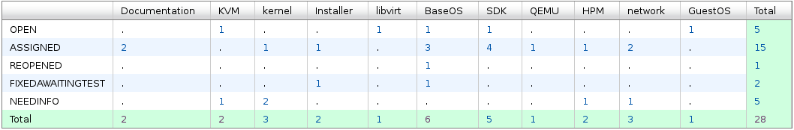
Vulcan - Open Defects
28 open defects exluding 24 HVM bugs.
13 defects new opened in the last two weeks. We solved 35 defects in the past two weeks.
Defect statistics:

Slide 3
Vulcan – High Priority Defects
No |  |  |  | Comp | Summary | Status | Comment
1 | 138613 | P1 | Ship issue | SDK | Customer is not able to install a Fixpack on a system with SDK installed | OPEN | Solutionsare being discussed.
2 | 137679 | P1 | High | BaseOS | sg_luns cannot display more than 1023 luns | ASSIGNED | -Fixed by increasing the size of internal buffer of sg_luns application. - Fix will be provided in Fix Pack 2.
3 | 136493 | P2 | High | Installer | Installation exited with error code: KVMIBMC002011 | ASSIGNED | Fix will be included in FP2.

Slide 4
Vulcan – All Defects
409 defects excluding 24 HVM defects opened in the Vulcan Bugzilla until now.

